Slide 1
Creating an AWS-EC2 Machine
By:
Bakinam Essawy

Slide 2
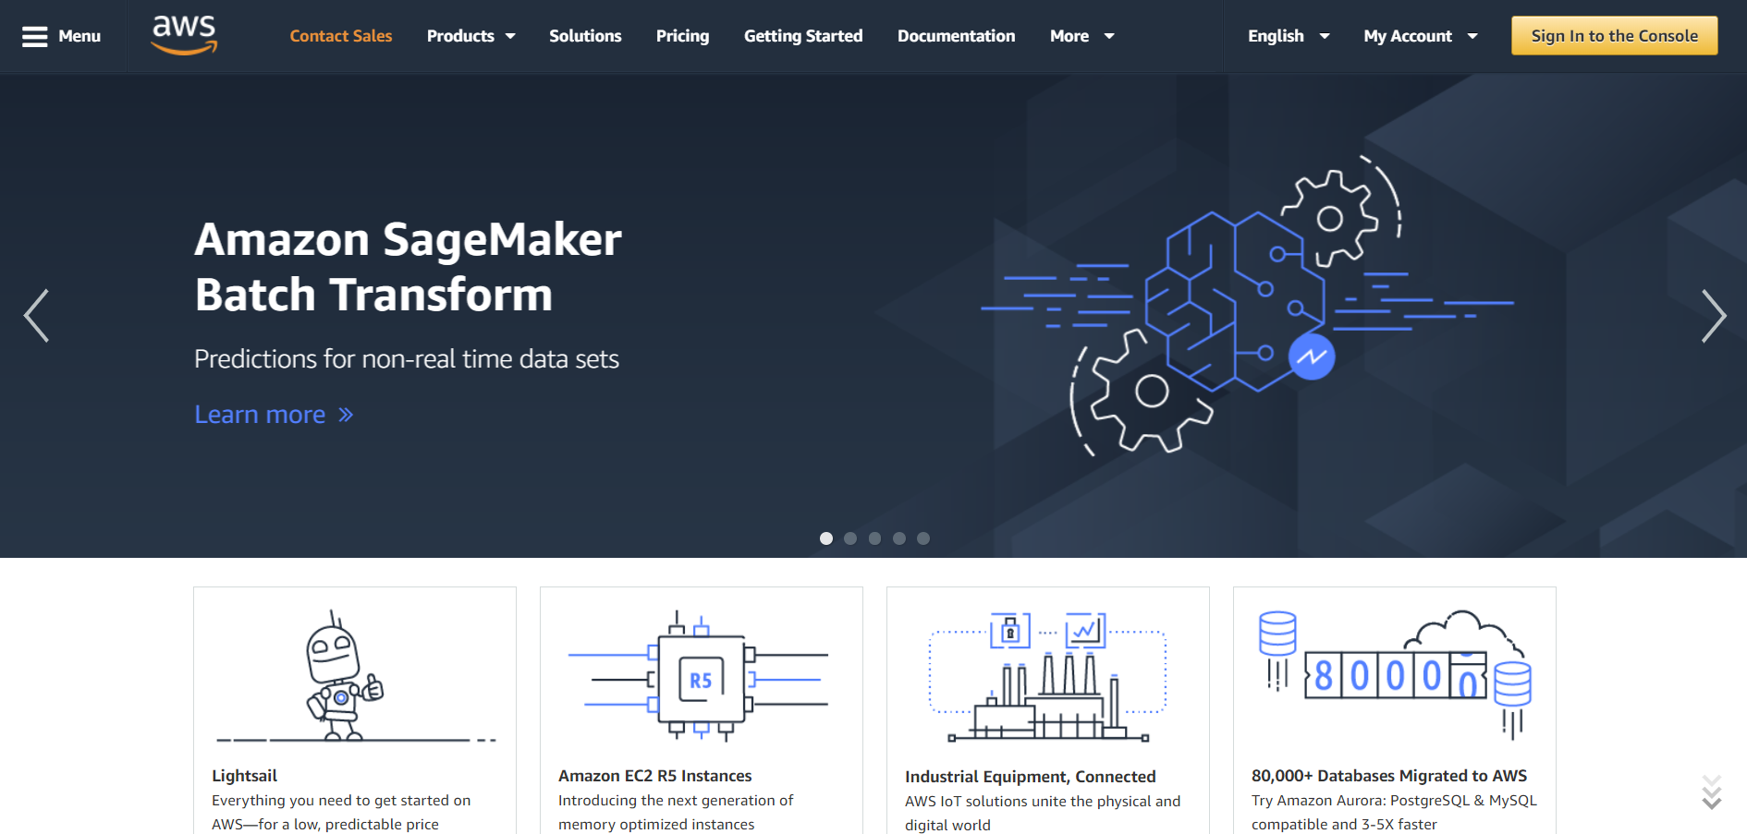
Create an Account on AWS
https://aws.amazon.com/

Slide 3
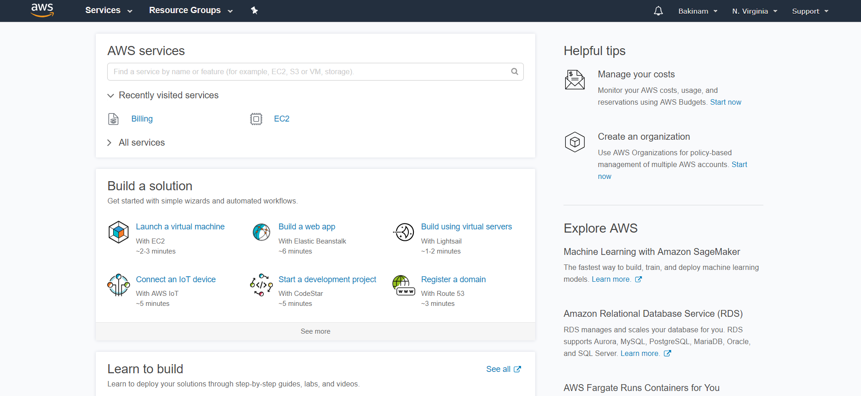
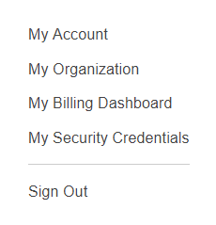
Adding credits
Once you are able to create an account and login, you can add your promo credit:

Slide 4
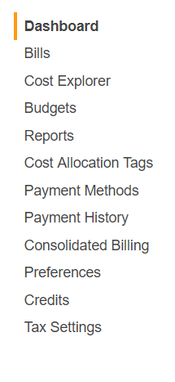
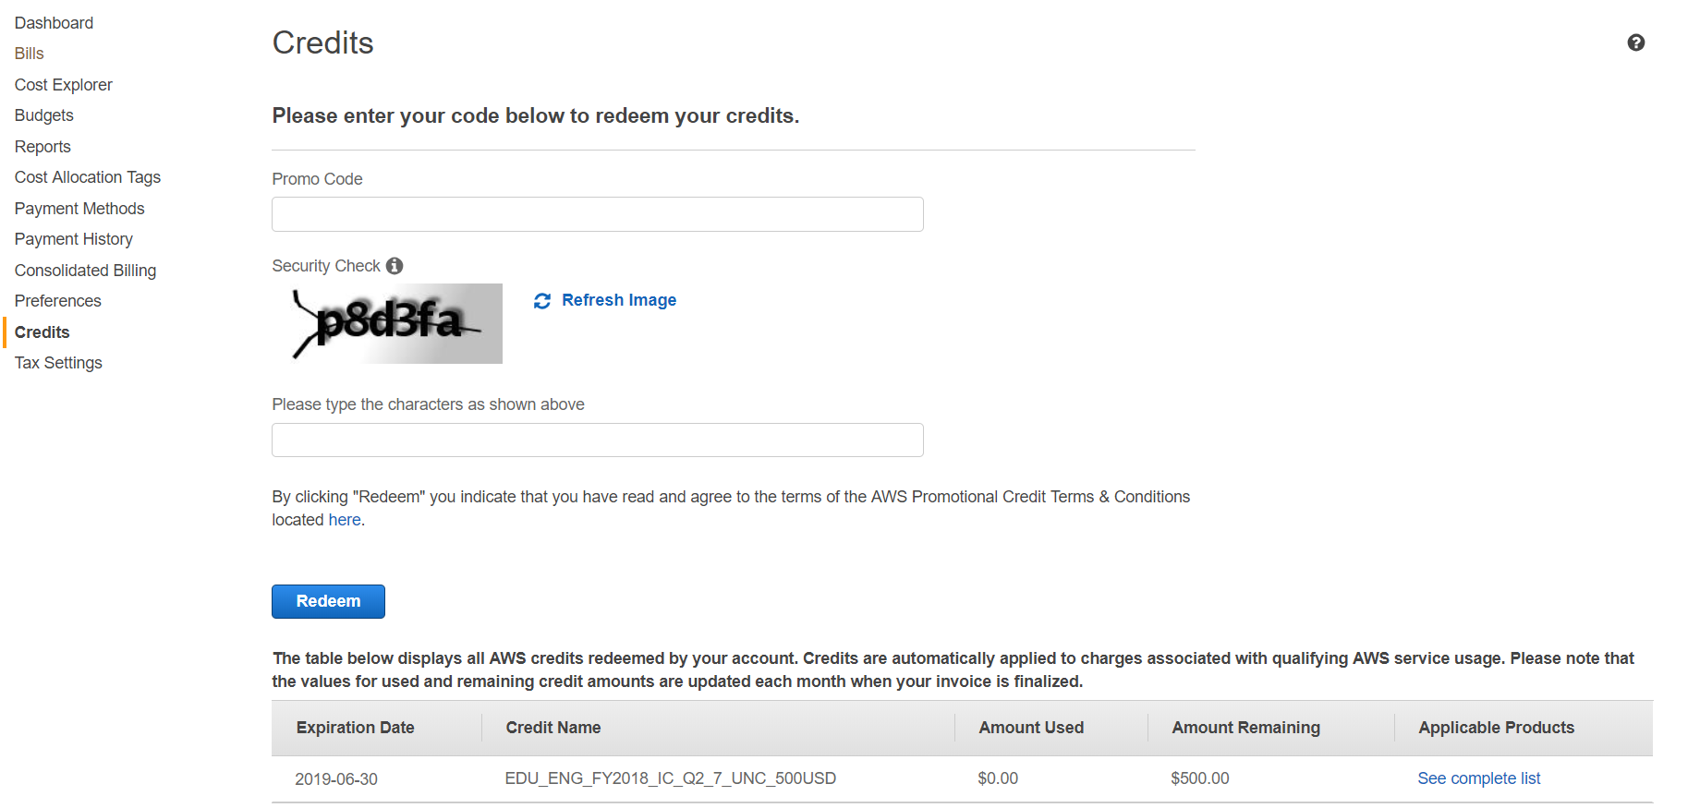
Adding credits to My Billing Dashboard

Slide 5
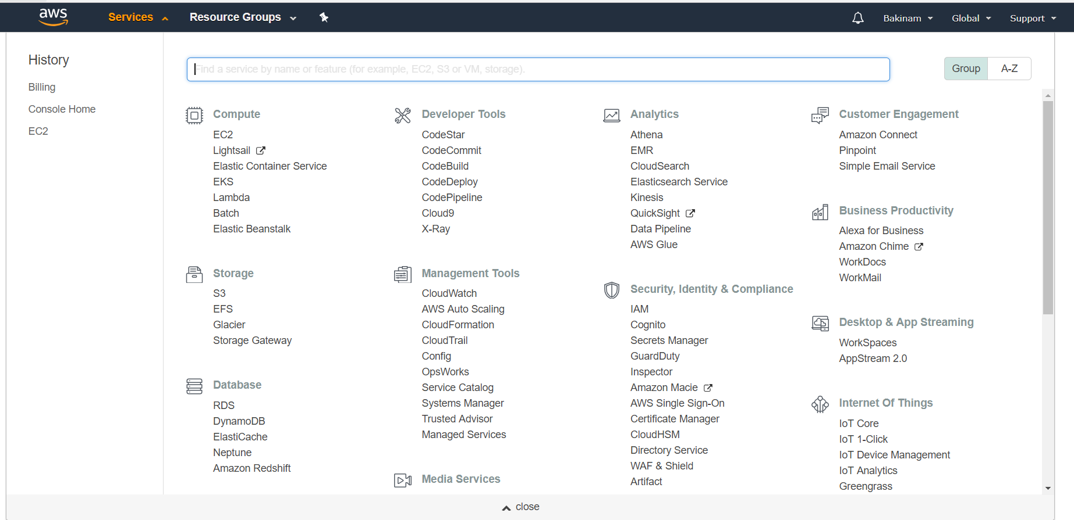
Creating AWS-EC2 through Services

Slide 6
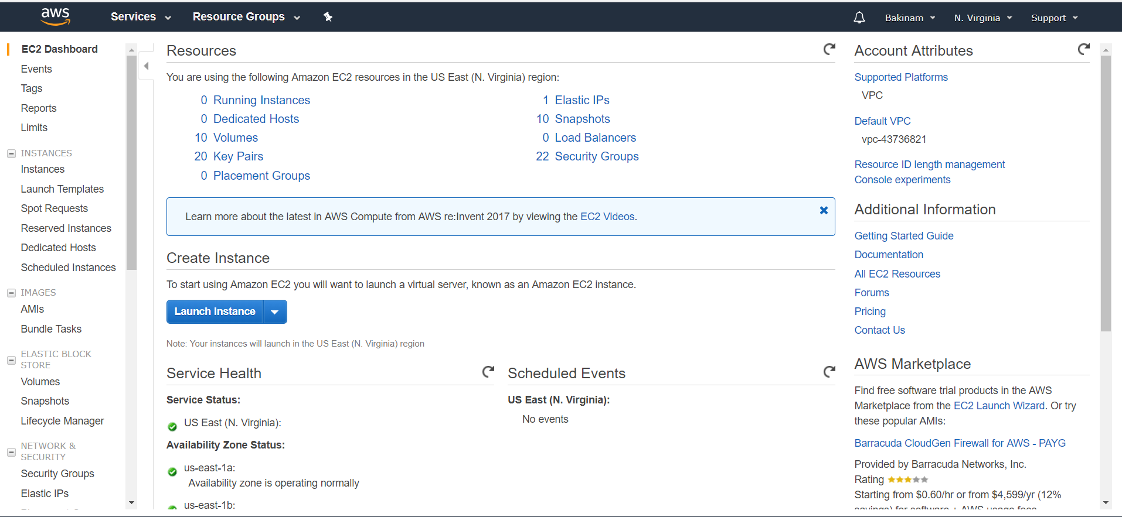
Lunching an EC2 machine

Slide 7
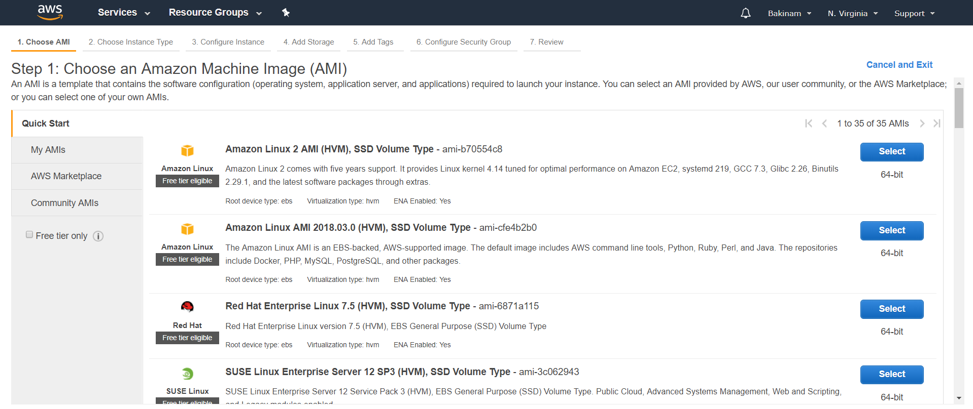
Lunching an EC2 machine

Slide 8
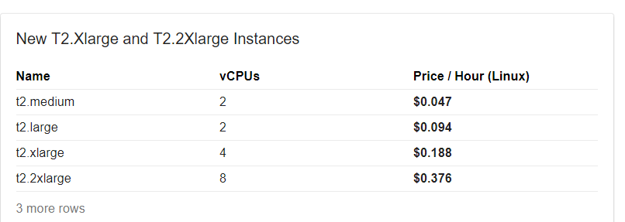
Pricing

Slide 9
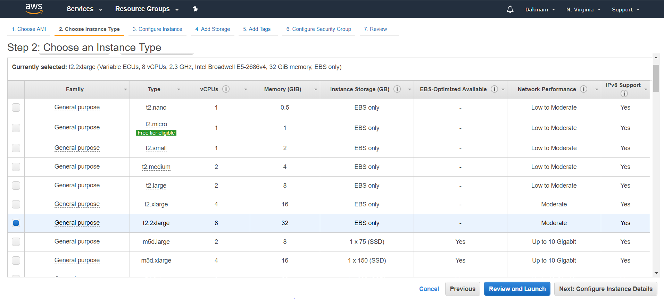
Choosing an Instance Type

Slide 10
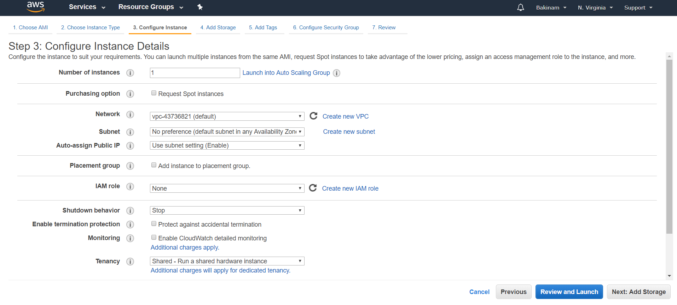
Configure Instance Details

Slide 11
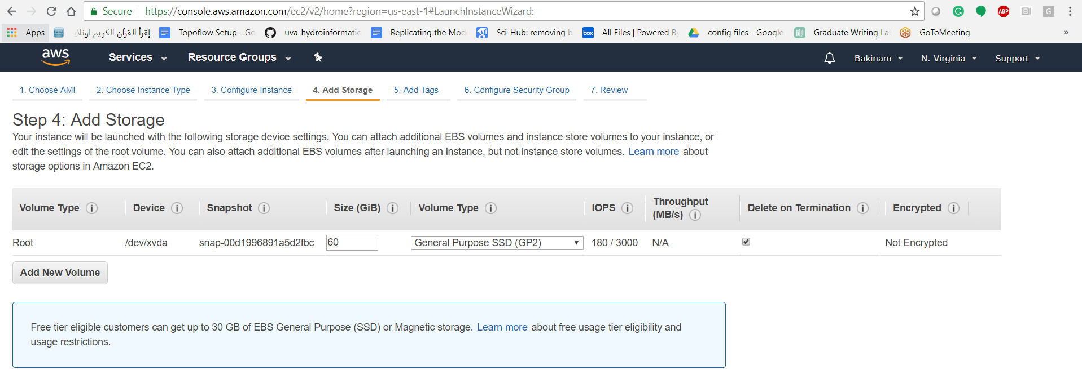
Adding storage

Slide 12
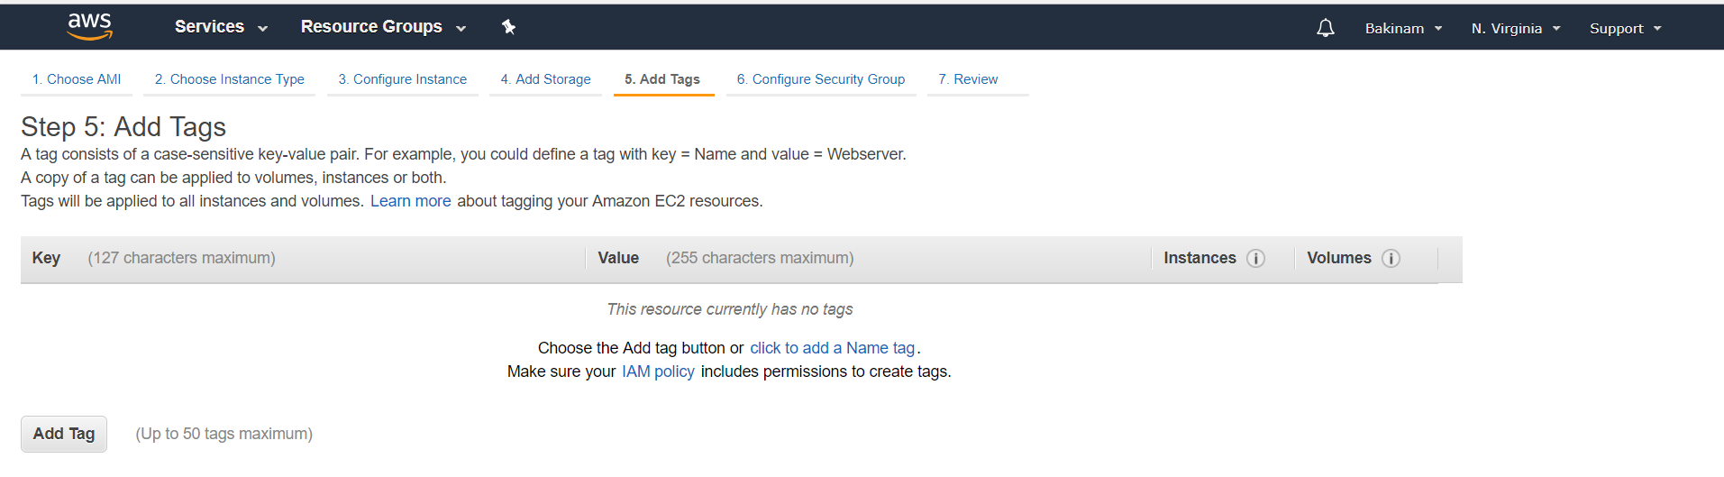
Add Tags

Slide 13
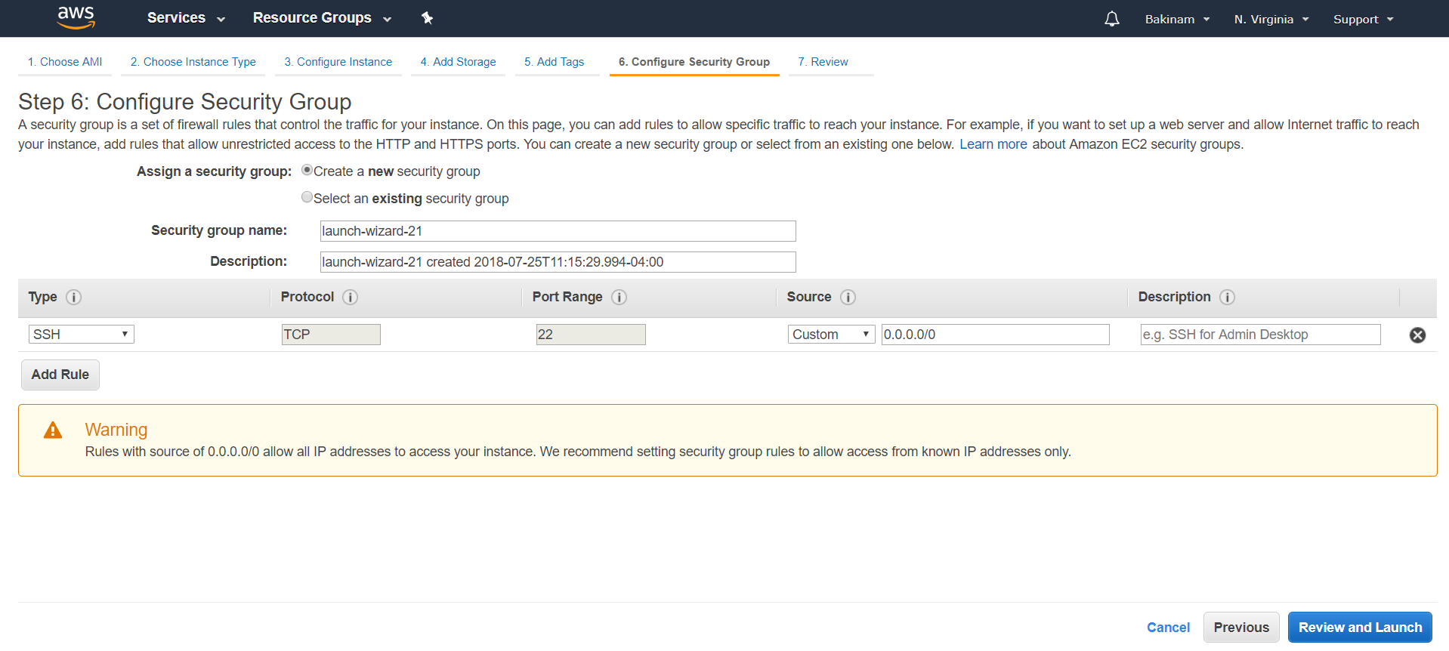
Configure Security Group

Slide 14
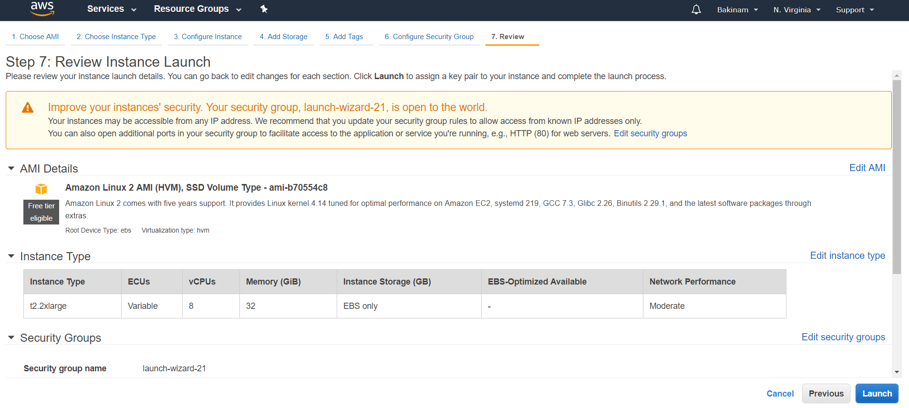
Review Instance Launch

Slide 15
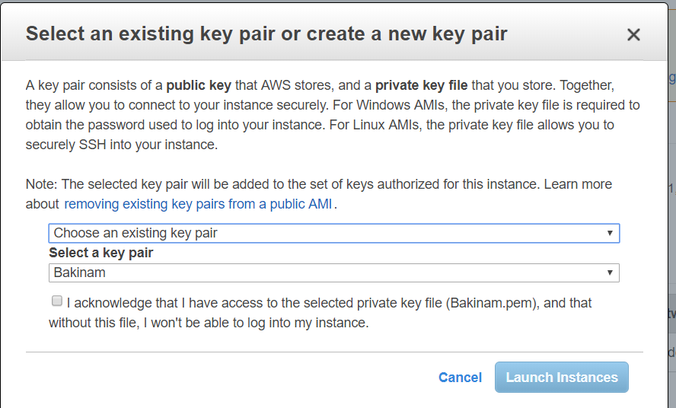
Creating the key pair

Slide 16
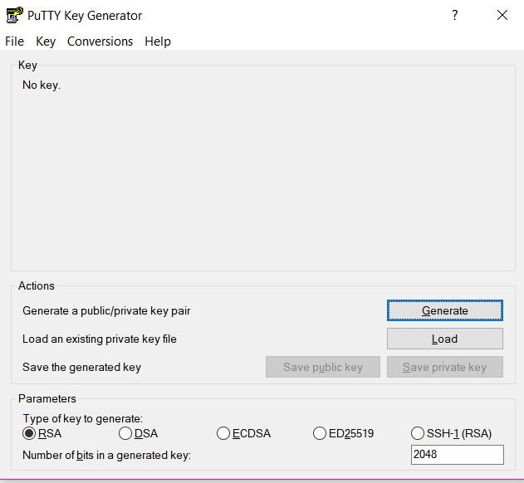
Launching your Instance
Use Puttygen.exe to generate the private key from using the downloaded key from the AWS.

Slide 17
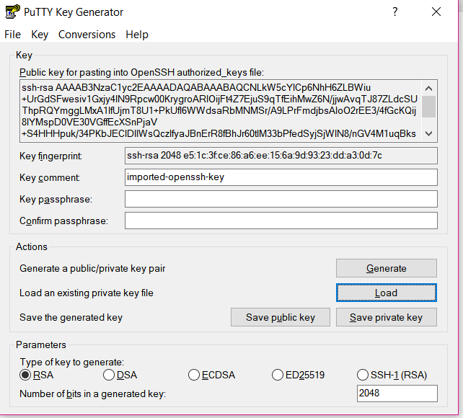
Generating the private key
Load the key downloaded from AWS-EC2 by clicking on load
Click on save private key
Save the private key in a safe place don't share it
The generated key will have *.ppk extension and this will be the key used to ssh to your aws-ec2 machine.

Slide 19
Start From Here

Slide 20
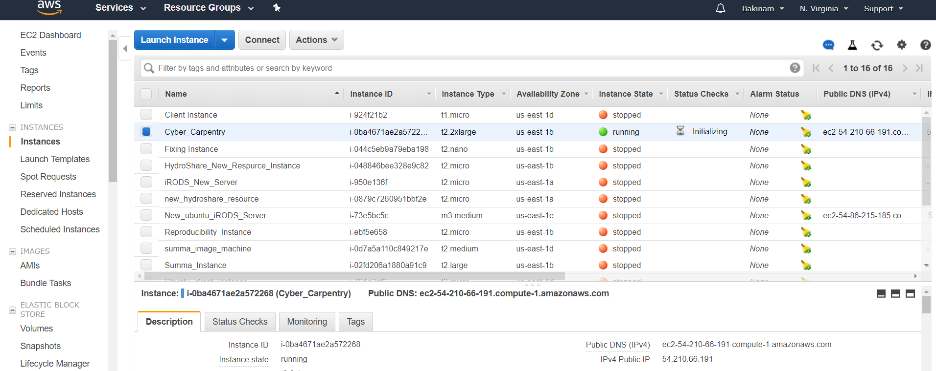
Ssh to the AWS-EC2 Machine from Putty
You will need the Cyber_Carpentry.ppk key pair and the ip address for the machine.
Every time you reboot the machine the ip address change unless you make the ip address elastic (fixed IP address).

Slide 21
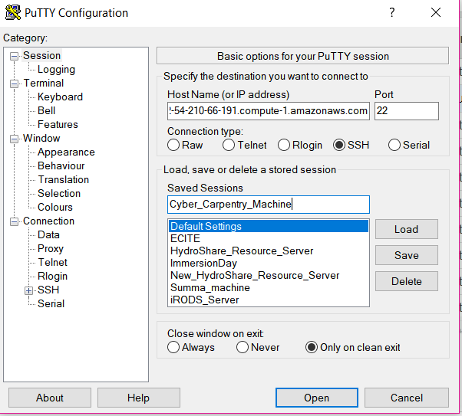
Ssh to the AWS-EC2 Machine from Putty
Insert the username@ip address her: example:
ec2-user@ec2-54-210-66-191.compute-1.amazonaws.com

Slide 22
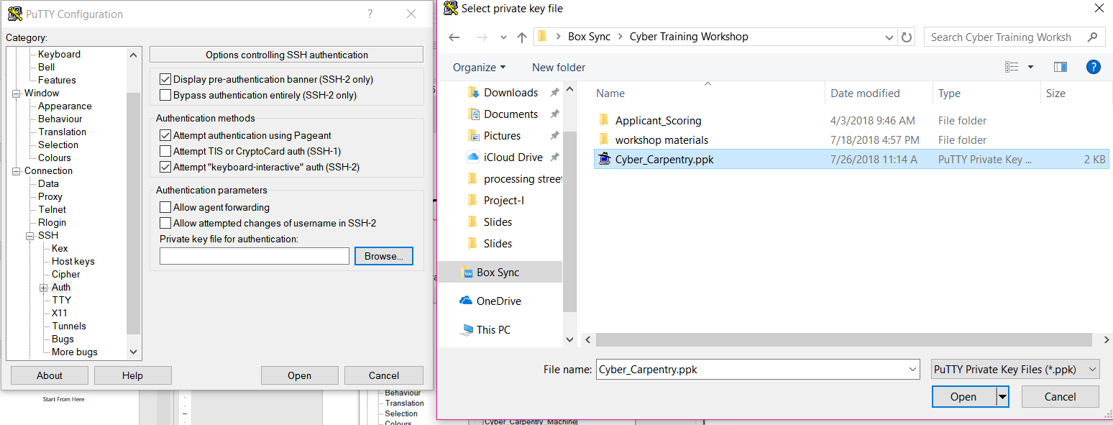
Ssh to the AWS-EC2 Machine from Putty

Slide 23
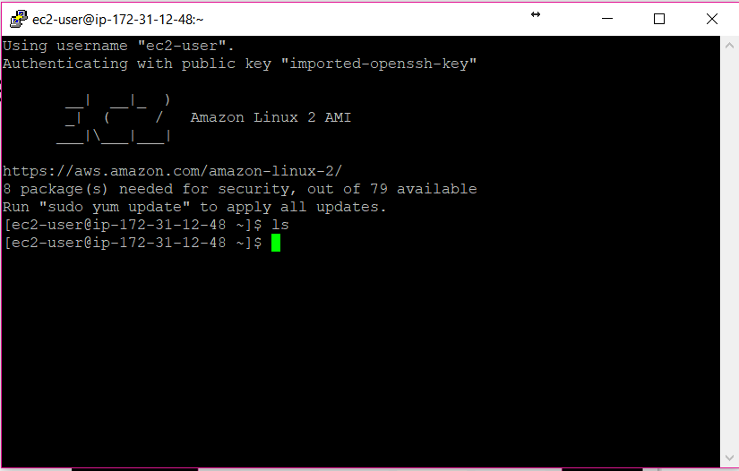
You are now on the EC2-Instance

Slide 24
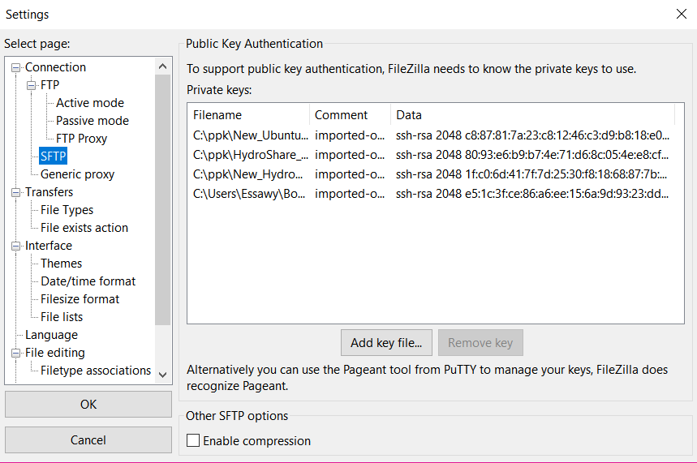
FileZilla to transfer files from your local machine to the EC2-machine
You could use any other software to transfer file like winscp. Use whatever you feel comfortable with.
From edit → settings to add the private key pair for your machine.

Slide 25
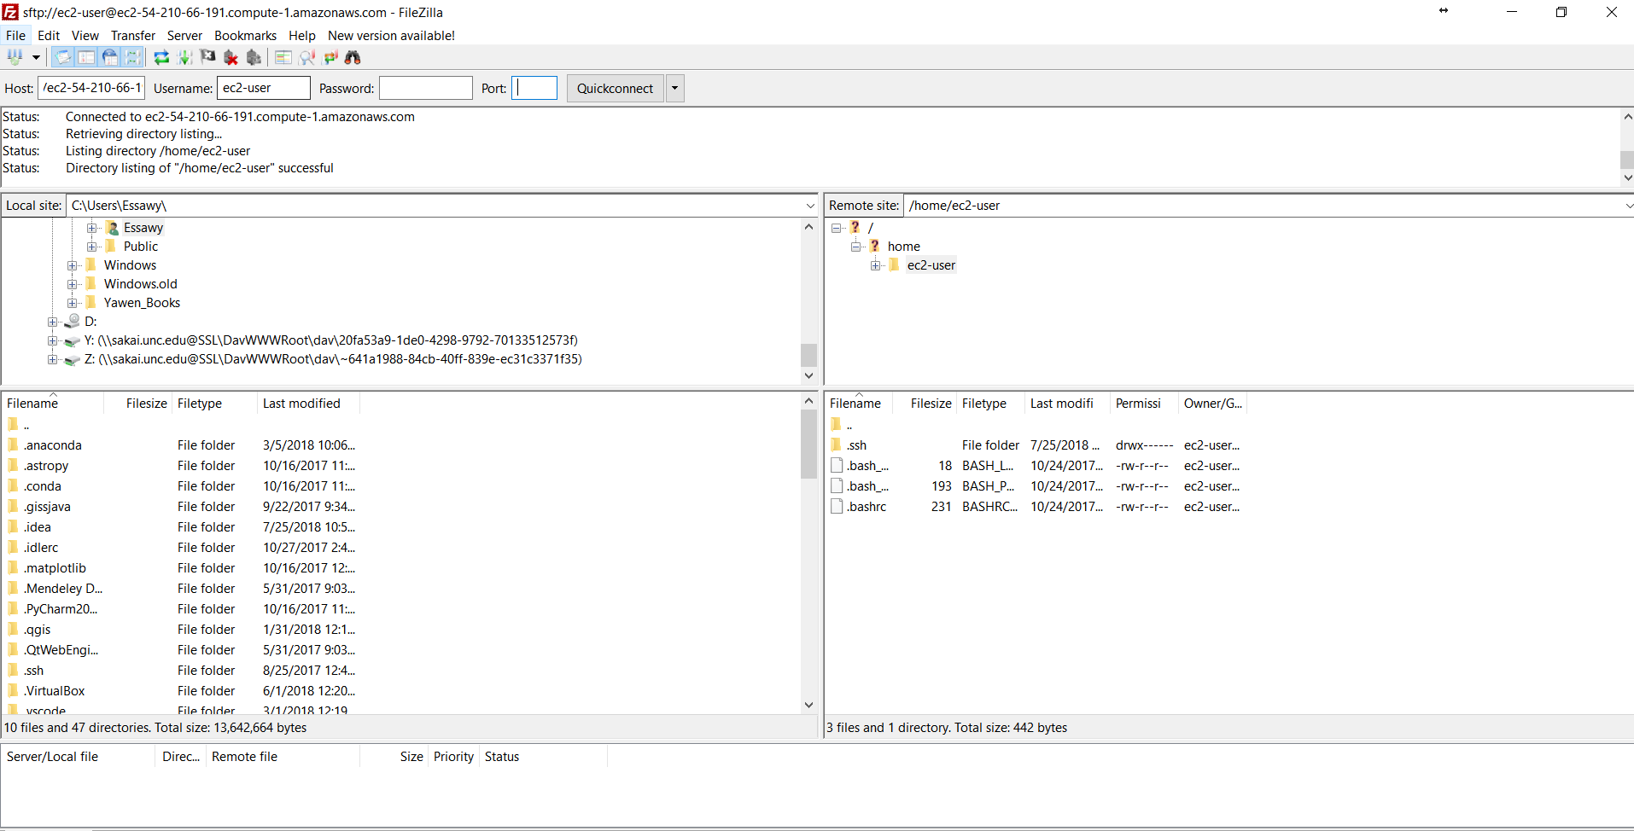
Add the Host (ip address), user name, and the port. Drag files to or from your EC2

